Slide 1
MATHS SPRINT
MATHEMATICS/SPEED

Slide 2
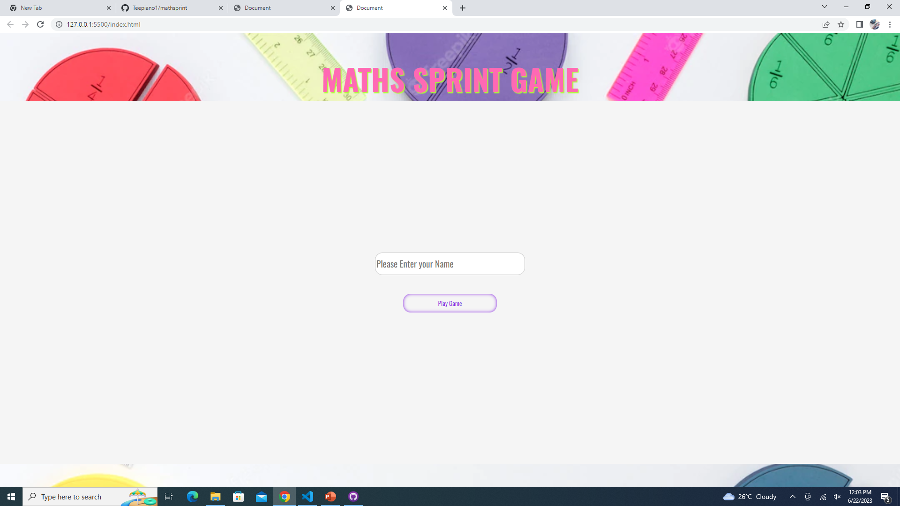
HOME PAGE

Slide 3
Problem statement

Slide 4
Future expansion

Slide 5
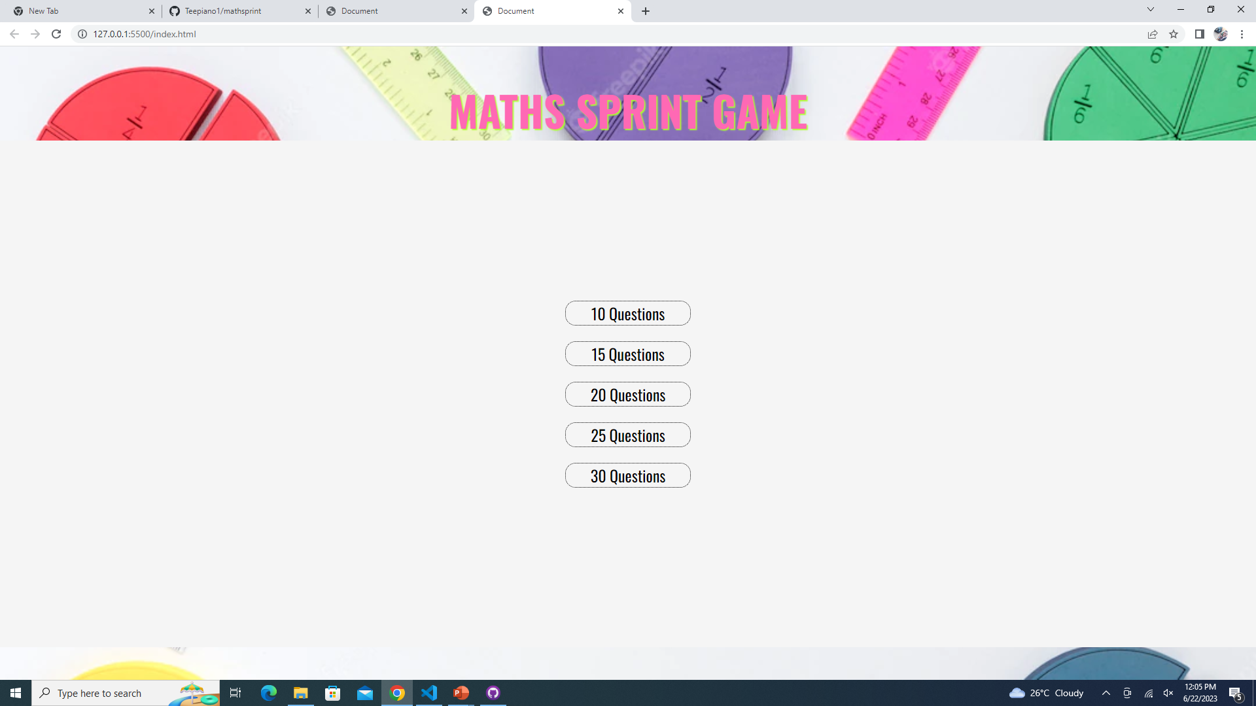
QUESTION SELECTION

Slide 6
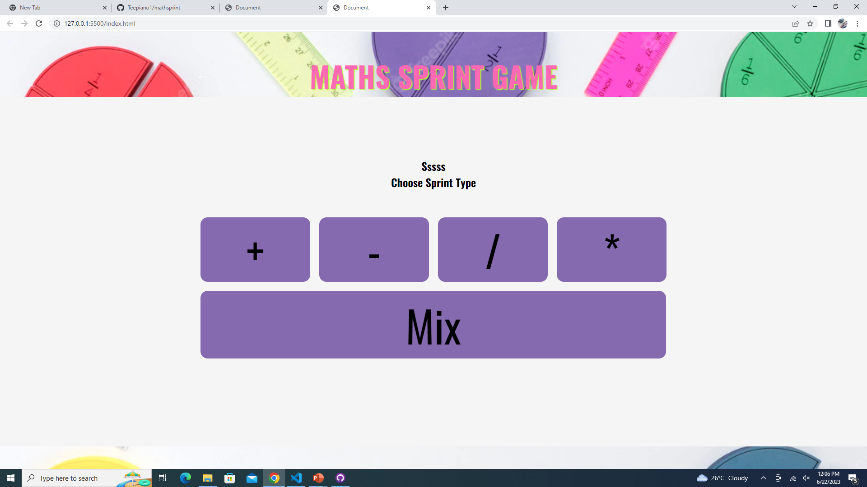

Slide 7
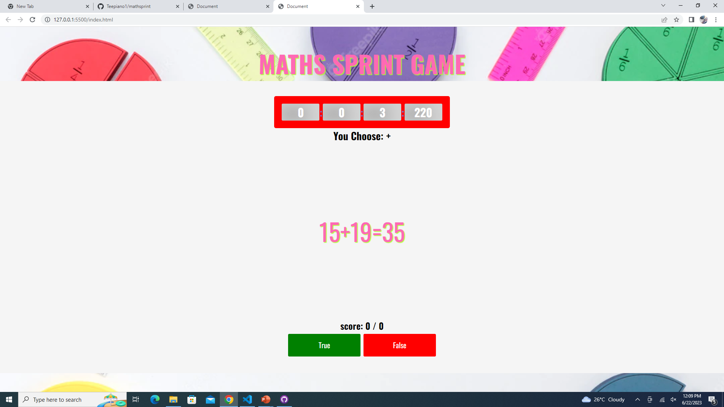

Slide 8
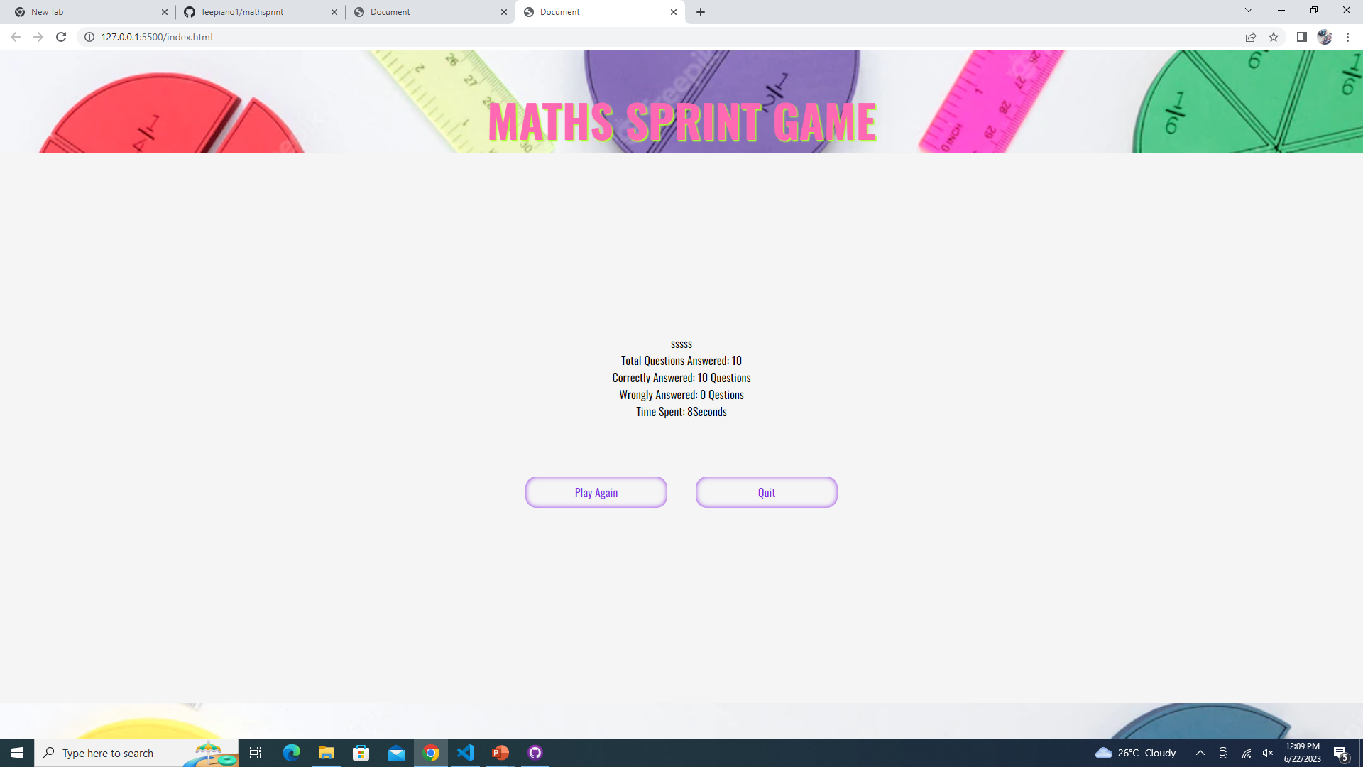

Slide 9
TEAM MEMBERS
ADEMUYIWA ADEKUNLE
OLABODE TOLULOPE
SOPITAN PRECIOUS
IKUJEBI KEHINDE
HERITAGE

